Slide 1
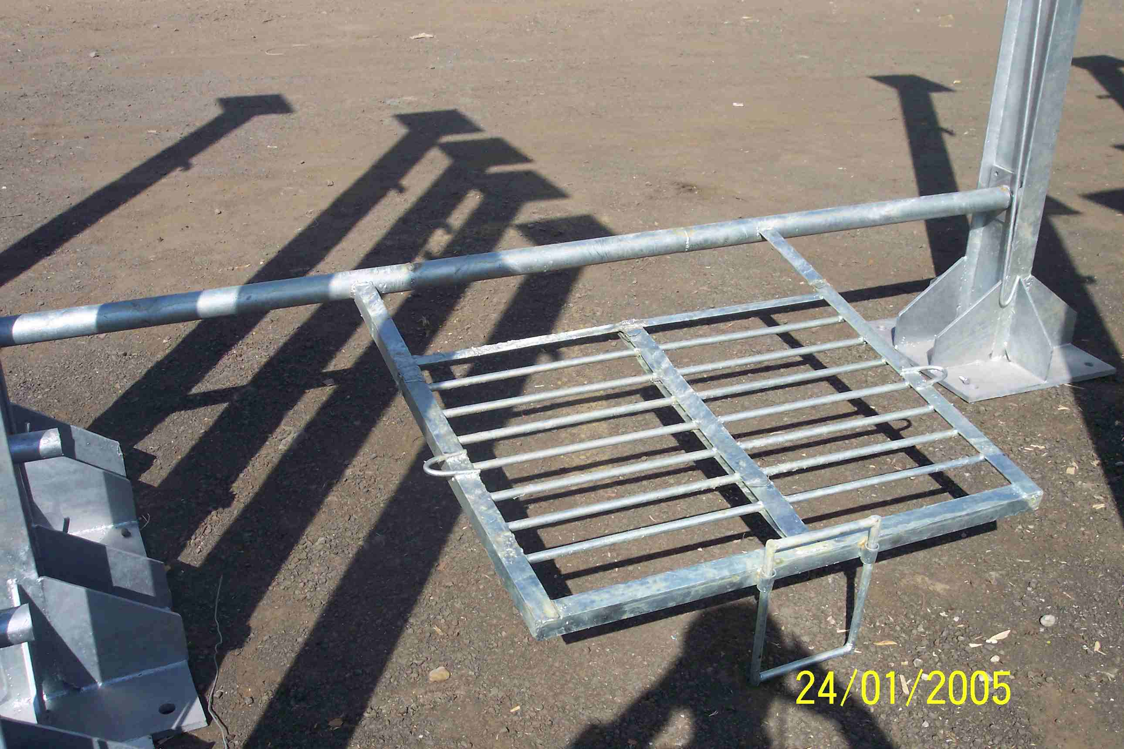
SIEMENS
HVCB SPARES
Platform arrangement for CB
72.5KV, 145KV CB
S4799120001

